Slide 1
Video Presentation of Research Proposal Assessment
WoongKeol Kim

Slide 2

Introduction and Purpose of the Video
Notes:
Artificial Intelligence (AI) has emerged as a transformative technology with profound implications across various sectors, including healthcare, finance, and transportation. As AI systems become increasingly integrated into society, ethical considerations in their development and deployment are paramount. The purpose of this paper is to develop and present a research idea on the ethical considerations in AI development, which could be further developed into a full proposal and conducted within a commercial or academic setting. This research aims to address critical ethical concerns such as bias, privacy, and accountability in AI systems, with the anticipation of providing actionable insights that will benefit both academia and industry.

Slide 3
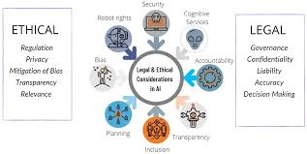
Context of the Research Idea
Notes:
The rapid advancement of AI technologies has brought significant benefits, but it has also raised ethical issues that need urgent attention. AI systems, when not properly designed, can perpetuate biases, invade privacy, and operate without clear accountability, leading to unintended and often harmful consequences. For instance, biased algorithms in hiring processes can lead to discriminatory practices against certain demographic groups, while AI surveillance technologies can infringe on individual privacy rights. The increasing reliance on AI necessitates a robust ethical framework to guide its development and implementation. According to Buchanan et al. (2011), ethical considerations in computer science, especially AI, are crucial for ensuring that these technologies serve the public good without causing harm. This research aims to explore these ethical dimensions, focusing on creating guidelines that can be adopted by AI developers and policymakers to mitigate these risks.
Managing this research project will involve several key steps. Initially, a comprehensive literature review will be conducted to understand the current landscape of ethical issues in AI. This will be followed by qualitative and quantitative data collection methods to gather insights from various stakeholders, including AI developers, ethicists, and policymakers. The project will also involve the development and testing of an ethical framework to assess its effectiveness in real-world AI applications. By adopting a mixed-methods approach, this research aims to provide a holistic understanding of the ethical challenges in AI development and propose practical solutions.

Slide 4
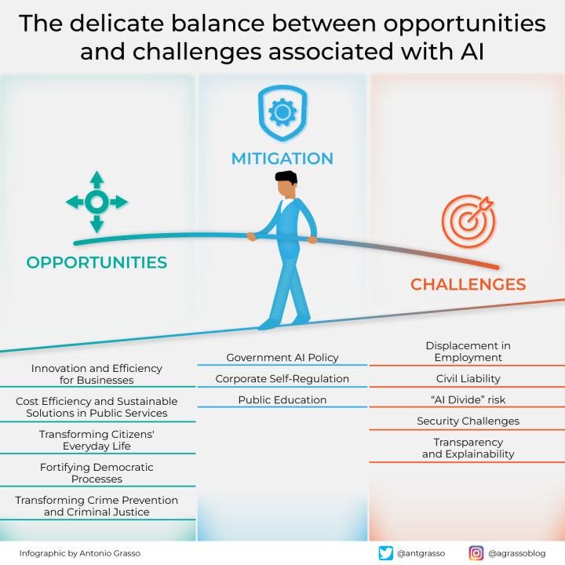
Hypothesis / Research Questions and Problem Statement
Notes:
The central hypothesis of this research is that integrating ethical considerations early in the AI development lifecycle can significantly mitigate risks associated with bias, privacy violations, and lack of accountability. This hypothesis is grounded in the belief that proactive ethical planning can lead to the development of more fair and transparent AI systems. The primary research questions guiding this study are: (1) What are the most critical ethical issues in current AI development practices? (2) How can ethical frameworks be effectively integrated into AI development processes? (3) What impact does early integration of ethical considerations have on AI system performance and trustworthiness?
The problem statement for this research is centered on the gap between the rapid development of AI technologies and the slower pace of ethical framework adoption. According to Gotterbarn et al. (2018), the lack of standardized ethical guidelines in AI development poses significant risks to society. Addressing these research questions will provide new insights into ethical AI development, offering solutions to enhance fairness and accountability. The expected outcome is the creation of a comprehensive ethical framework that can be integrated into AI development processes, thereby reducing ethical risks and improving public trust in AI technologies.

Slide 5
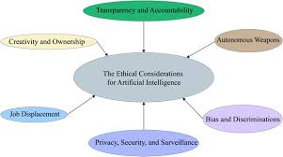
Research Methodology and Proposed Methods
Notes:
This research will adopt a mixed-methods approach, combining qualitative and quantitative techniques to ensure a comprehensive analysis of the ethical issues in AI development. The qualitative component will involve conducting semi-structured interviews with key stakeholders in AI development, including developers, ethicists, and policymakers. These interviews will provide in-depth insights into the ethical challenges faced by these professionals and their perspectives on potential solutions. According to Abazi-Bexheti et al. (2020), qualitative methods are essential for capturing the nuanced views and experiences of individuals involved in AI development.
The quantitative component will involve distributing surveys to AI practitioners to gather data on the prevalence of ethical practices and challenges in the field. This data will be analyzed to identify common ethical issues and measure the effectiveness of proposed ethical frameworks. The surveys will include questions related to the integration of ethical considerations in AI development, the impact of these considerations on AI performance, and the perceived effectiveness of existing ethical guidelines. By combining qualitative and quantitative methods, this research aims to provide a holistic understanding of the ethical landscape in AI development and propose practical solutions that can be adopted by the industry and academia.

Slide 6
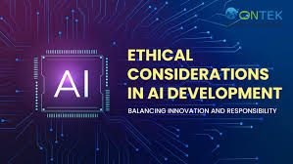
Data Collection Strategy
Notes:
The data collection strategy for this research will involve multiple approaches to ensure a comprehensive understanding of the ethical issues in AI development. Firstly, semi-structured interviews will be conducted with AI developers, ethicists, and policymakers. These interviews will be recorded and transcribed, and thematic analysis will be used to identify key themes and insights related to ethical challenges and solutions. According to Berndtsson et al. (2007), semi-structured interviews are effective for exploring complex issues and gaining detailed insights from participants.
Secondly, surveys will be distributed to AI practitioners to gather quantitative data on ethical practices and challenges in the field. The surveys will include both closed-ended and open-ended questions to capture a wide range of responses. The quantitative data will be analyzed using statistical methods to identify trends and measure the effectiveness of proposed ethical frameworks. This approach will provide valuable metrics on the prevalence of ethical issues in AI development and the impact of integrating ethical considerations into the development process.
Additionally, existing AI systems will be analyzed to identify ethical shortcomings and assess the impact of proposed frameworks. This analysis will involve reviewing the design and implementation of AI systems to identify areas where ethical considerations are lacking and propose improvements. The data collected through these methods will inform the development of ethical guidelines and validate the research hypothesis. This multi-faceted data collection strategy will ensure a comprehensive understanding of the ethical landscape in AI development and provide actionable insights for improving ethical practices.

Slide 7
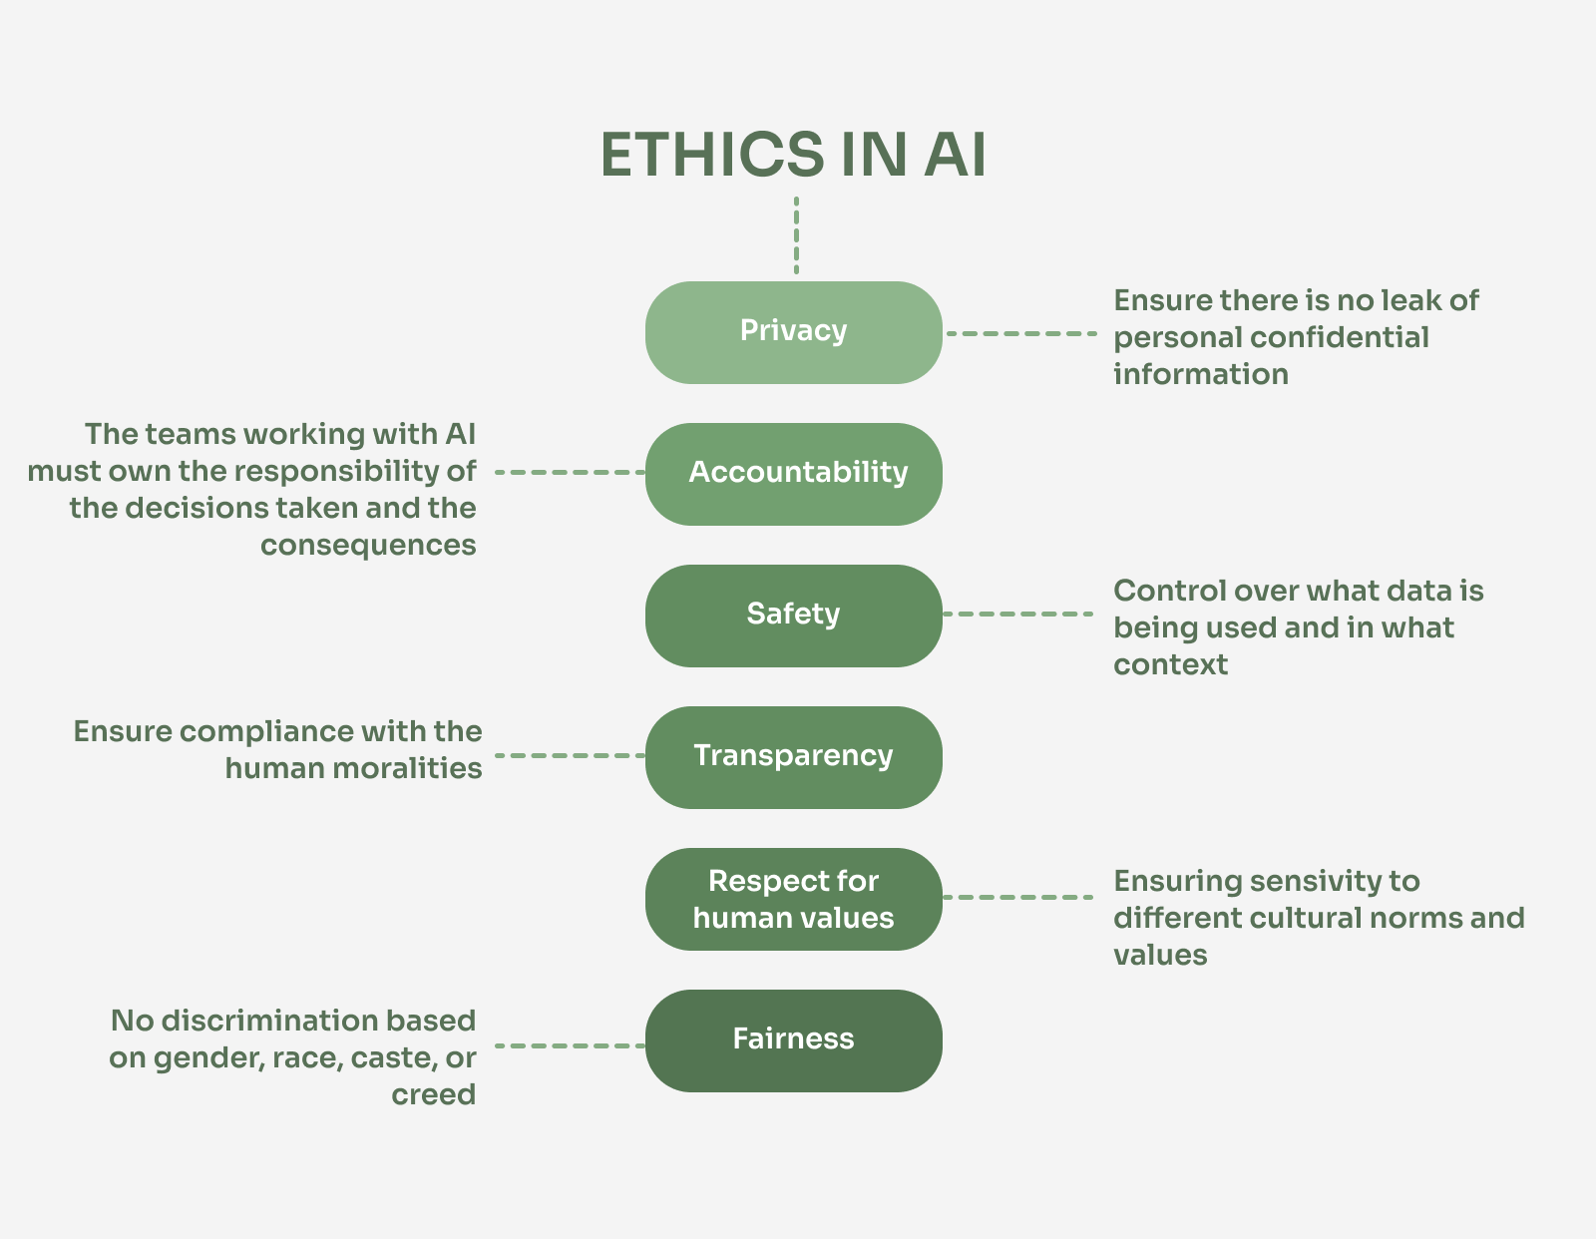
Preliminary Review of the Analysis of the Results
Notes:
Preliminary analysis of the interview data is expected to reveal common ethical issues such as algorithmic bias and privacy concerns. Thematic analysis will identify key themes and insights related to these issues, providing a deeper understanding of the ethical challenges faced by AI developers. Quantitative analysis of the survey data will provide metrics on the prevalence of these issues and the perceived effectiveness of ethical frameworks. This analysis is expected to show that many AI practitioners are aware of ethical challenges but lack the tools and guidelines to effectively address them.
According to Barocas and Boyd (2017), addressing ethical considerations in AI development requires a combination of technical solutions and ethical guidelines. The preliminary findings are expected to uncover significant gaps in current practices and highlight the need for comprehensive ethical frameworks that can be integrated into AI development processes. These findings will inform the development of practical recommendations for AI developers and policymakers, aimed at enhancing fairness, accountability, and transparency in AI systems.
The anticipated outcomes of this research include the identification of key ethical issues in AI development, the development of a comprehensive ethical framework, and the validation of this framework through empirical analysis. By addressing these issues, this research aims to contribute to the development of more ethical and trustworthy AI systems, thereby improving public trust and acceptance of AI technologies.

Slide 8
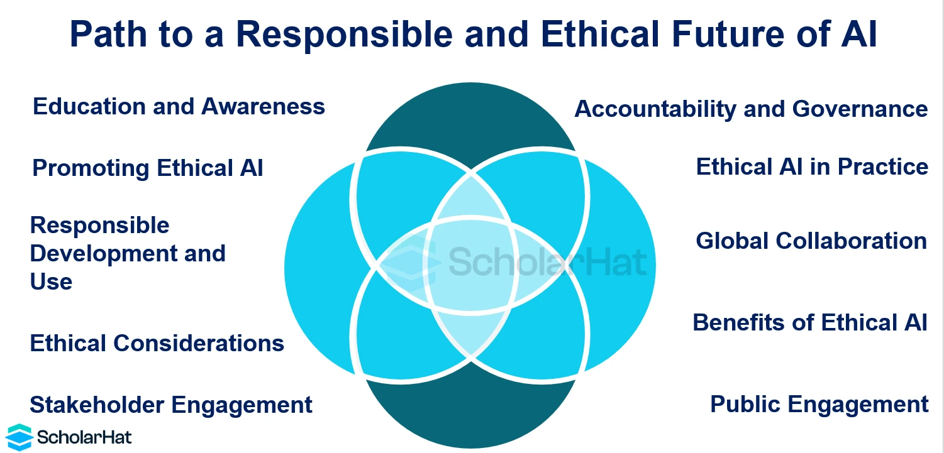
Contribution to Current Body of Knowledge
Notes:
This research will contribute significantly to the current body of knowledge by providing a structured approach to integrating ethics into AI development. In an academic setting, it will enhance the theoretical understanding of ethical AI practices, offering new insights into the ethical challenges and potential solutions in AI development. This research will also provide valuable contributions to the field of AI ethics, which has been growing in importance as AI technologies become more pervasive.
In a commercial environment, the findings of this research will offer practical guidelines for AI developers, fostering responsible innovation and building public trust in AI technologies. The proposed ethical framework will provide AI developers with the tools and guidelines needed to address ethical challenges effectively, ensuring that AI systems are designed and implemented in a manner that is fair, accountable, and transparent. According to Gotterbarn et al. (2018), the adoption of ethical guidelines in AI development can significantly enhance the public trust and acceptance of AI technologies.
Furthermore, this research will inform policymakers and regulatory bodies on the importance of integrating ethical considerations into AI development. The findings will provide evidence-based recommendations for the development of policies and regulations aimed at ensuring the ethical use of AI technologies. By bridging the gap between ethical theory and practical application, this research aims to contribute to the development of a more ethical and responsible AI landscape.

Slide 9
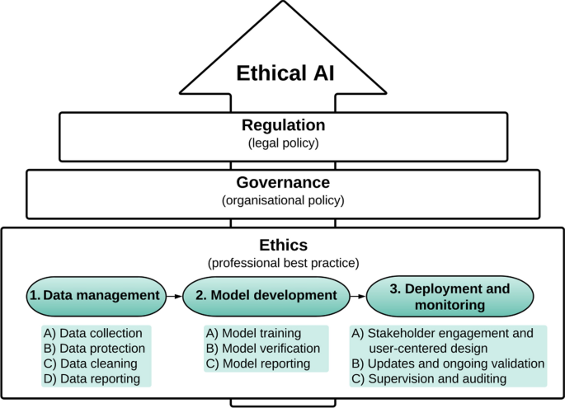
Conclusion
Notes:
In conclusion, addressing ethical considerations in AI development is crucial for creating fair, accountable, and trustworthy AI systems. This research aims to bridge the gap between ethical theory and practical application by developing a comprehensive ethical framework that can be integrated into AI development processes. The expected outcomes of this research include the identification of key ethical issues in AI development, the development of practical guidelines for AI developers, and the validation of these guidelines through empirical analysis. By addressing these issues, this research aims to contribute to the development of more ethical and trustworthy AI systems, thereby improving public trust and acceptance of AI technologies. Thank you for your attention, and I look forward to your feedback.

Slide 10
References
Abazi-Bexheti, L., Kadriu, A. and Apostolova, M., 2020, September. Word Cloud Analytics of the Computer Science Research Publications’ Titles over the Past Half Century. In 2020 43rd International Convention on Information, Communication and Electronic Technology (MIPRO) (pp. 887-892). IEE. https://ieeexplore.ieee.org/abstract/document/9245141/
Barocas, S., & Boyd, D. (2017). Engaging the ethics of data science in practice. Communications of the ACM, 60(11), 23-25. https://dl.acm.org/doi/fullHtml/10.1145/3144172
Berndtsson, M., Hansson, J., Olsson, B. and Lundell, B., 2007. Thesis projects: a guide for students in computer science and information systems. Springer Science & Business Media.
Buchanan, E., Aycock, J., Dexter, S., Dittrich, D. and Hvizdak, E., 2011. Computer science security research and human subjects: Emerging considerations for research ethics boards. Journal of Empirical Research on Human Research Ethics, 6(2), pp.71-83. https://www.researchgate.net/profile/Scott-Dexter-3/publication/51226554_Computer_Science_Security_Research_And_Human_Subjects_Emerging_Considerations_For_Research_Ethics_Boards/links/0046352b2fa14d36a5000000/Computer-Science-Security-Research-And-Human-Subjects-Emerging-Considerations-For-Research-Ethics-Boards.pdf
Gotterbarn, D.W., Brinkman, B., Flick, C., Kirkpatrick, M.S., Miller, K., Vazansky, K. and Wolf, M.J., 2018. ACM code of ethics and professional conduct. https://dora.dmu.ac.uk/bitstream/2086/16422/1/acm-code-of-ethics-and-professional-conduct.pdf

